Slide 1
Hexadecimal arithmetic
Lecturer: Jay A. Abaleta

Slide 2
Hexadecimal Number System
Uses 10 digits and 6 letters, 0,1,2,3,4,5,6,7,8,9,A,B,C,D,E,F.
Letters represents numbers starting from 10. A = 10, B = 11, C = 12, D = 13, E = 14, F = 15.
Also called base 16 number system.
Each position in a hexadecimal number represents a 0 power of the base (16). Example − 16⁰
Last position in a hexadecimal number represents an x power of the base (16). Example − 16^{x} where x represents the last position - 1.

Slide 3
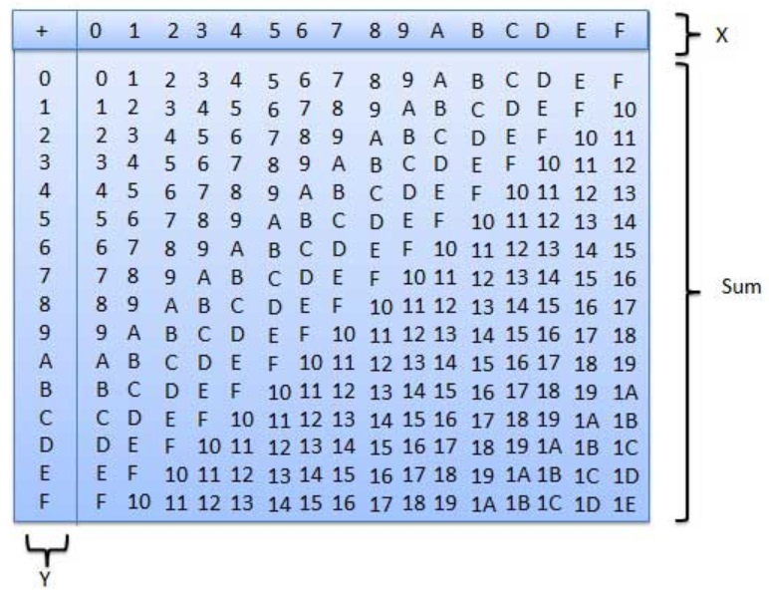
The Hexadecimal Addition table

Slide 4
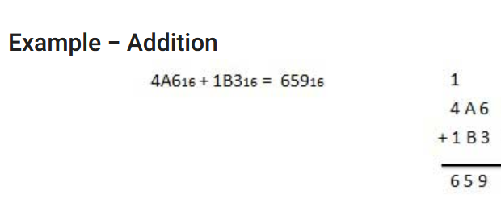
The Hexadecimal Addition
6+3 = 9
10+11 = 21
21/16 =Q-1 R-5
1+4+1 = 6

Slide 5

The Hexadecimal Subtraction
The subtraction of hexadecimal numbers follow the same rules as the subtraction of numbers in any other number system.
The only variation is in borrowed number.

Slide 6
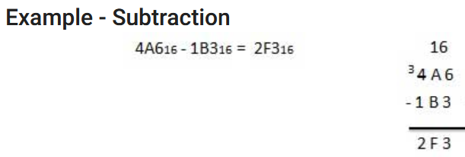
The Hexadecimal Subtraction

Slide 7
The Hexadecimal Multiplication
The multiplication process of Hexadecimal numbers are same as other number systems. You can verify your result by using this.
The points you should keep in mind while multiplying hexadecimal numbers:
If the sum exceeds 15 ( 0,1,2,3,4,5,6,7,8,9, A,B,C,D,E,F) you need to evaluate the equivalent hexadecimal value.
Divide the number by 16 and find its equivalent hexadecimal value. Quotient is going to be carry while remainder taken as sum

Slide 8
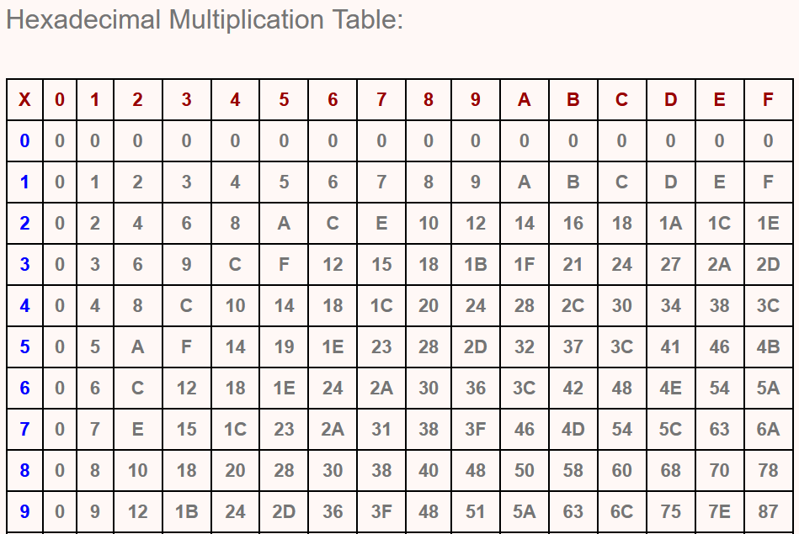
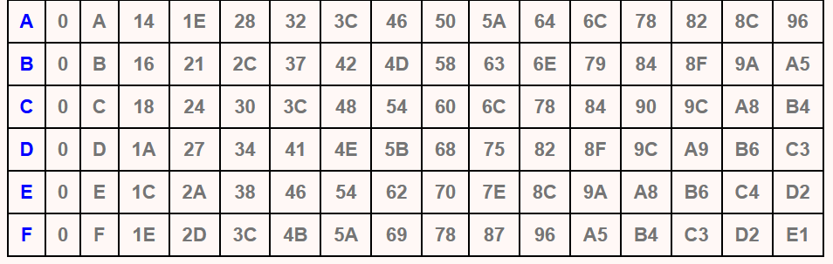
The Hexadecimal Multiplication

Slide 9
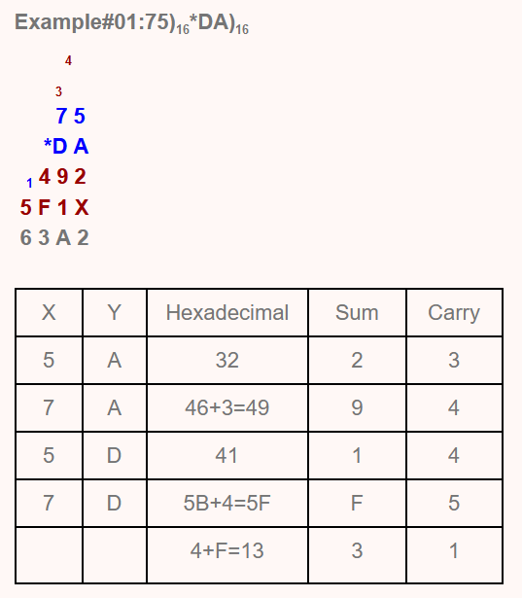
Hexadecimal Multiplication
A*5
10*5=50
50/16 Q3, R2, S2
A*7
10*7 =70
70/16 = Q4, R6, S9
13(D)*5=65
65/16 = Q4, R1, S1
13(D)*7 = 91
91/16 = Q5, R=11(B),S-15(F)

Slide 10
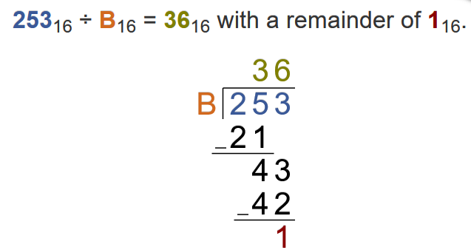
The Hexadecimal Division
To solve division examples you must know how to perform multiplication on octal numbers.
Example:
Decimal - 11(B)*3 = 33
33/16 = Q2,R1= S21
11(B)*6 = 66
66/16 = Q4,R2, S42

